Slide 1
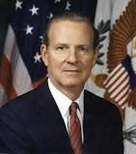
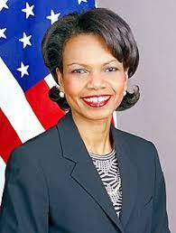
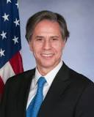
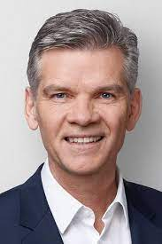
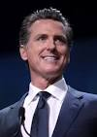

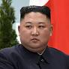
Secretary of State
United States of America
former United States Secretary of State
former Vice President
Roth v. US
xml
Roth v. US
braun
JFK(Goethe Gymnasium)
Ross, California, Ross, HQ
Dual Income
Ibm.damiler.accnetuer.paybhtouch.Andrew.?
Ibm.dmiler.accnete.paytbyou.sabry.tozin
Bimd.miler.acneet.paybytou.stephani.tozin
HOMICIDE:LUX(lottery 777)
Roth v. US
777 West Middlefield, Moutain View
7473 Quartz Circle, Dublin Califonria
Chair(apple
Chair(sap)
Tim cook
Sergay Bring
Jerry Yang
Morgan Freman
Josph Saunders
Ibm.damiler.mgm(micha)
Gorbache(micha)

Slide 2
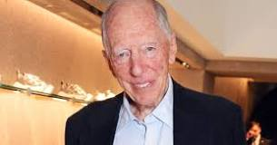
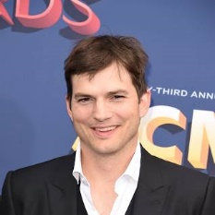
PENTAGON(deere) YANKKEE,jeff
INGO(presenter drunk Samul Adema ATB Jeff:Jason)
Harold
Kit, Anselmo
HOMICDIE.Whitehouse.MYLK(
Franceo beats up
Delle Donnas boyfrine
In front of Poclei Statoin
)
Wedding crashers
Ibm.dmiler.employe.vingig.rometti
Delle donna
Harold – Sysvets Stalon door right ( ACTOMFACTORY(damilerlee)
Harled – Lisa sex with daughter
Harold - German
Harold – Beath up by ASIANS peop at school trainstain
Harold –whitehouse( take house under) gmx,altavisa,darknet HOMICDIE:REISER SUSE Oalkand IBM, OS, ipx roth.ibm.damiler
Harold …
YANDKE PENTAGON
1998,2013 Homcie(Mayro(<s>Ariana Arbruster,weddingcrashers</s>)
Whitehouse(cheeryter(girefreindl MAINSTEET ghoceho(dj)))
MYLK( guy looks like asson kuch kit.stanord.pope.francsio)
who got beat up

Slide 3
Secretary of State
United States of America
former United States Secretary of State
former Vice President
Roth v. US
Roth v. US
xml
MARY
Roth v. US
braun
JFK(Goethe Gymnasium)
!JFK
MLK
SQ 2007 IPX 1997 MANNHEIM

Slide 4
Secretary of State
United States of America
1994 Mary lives on CAR(car-benz-streasse)
1995
1997 Mary lives in PRISIONER(Mannheim)
2007
I live at US Army Barak in Germany
Because of NATO and the US Constition
As well as Konrad Adenauer Constition
And important Checkpoint Charlie
JFK
!JFK.MLK
SQ 2007 IPX 1997 MANNHEIM

Slide 5
Secretary of State
United States of America
1994 Mary lives on CAR(car-benz-streasse)
1995
1997 Mary lives in PRISIONER(Mannheim)
2007
I live at US Army Barak in Germany
Because of NATO and the US Constition
As well as Konrad Adenauer Constition
And important Checkpoint Charlie
!JFK.MLK
JFK
SQ 2007 IPX 1997 MANNHEIM
2027 2017 CHARLES

Slide 6
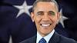
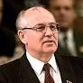
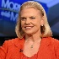
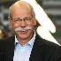

Secretary of State
United States of America
Call you Doctor Rice
I live at US Army Barak in Germany
Because of NATO and the US Constition
As well as Konrad Adenauer Constition
And important Checkpoint Charlie
JFK
!JFK.MLK
This is
Micha from
Unimog Michelbach
He is black
0.1 IBM.DMAIL.MGM(micha)
Cherytree(2013-2017) CHARLES
?

Slide 7
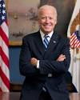

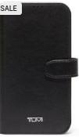
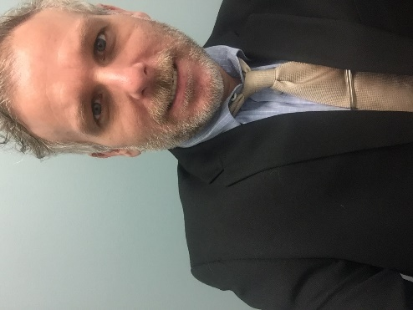
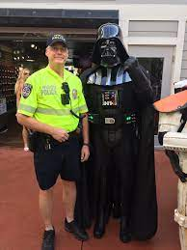
?
FBI
Secretary of State
United States of America
1004 Newpaper
?
?
1997 Karstadt
Call you Doctor Rice
2003 John Deere
2023
WMD
?
2016
Rich Makler,Walnut Creek, IBM
Tahoe Cabin
Death valley
Death valley
Apple Legal Council
SAP Legal Council
Visa hand Legal Council
Cyberous Legal Cournt hand

Slide 8

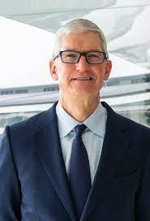

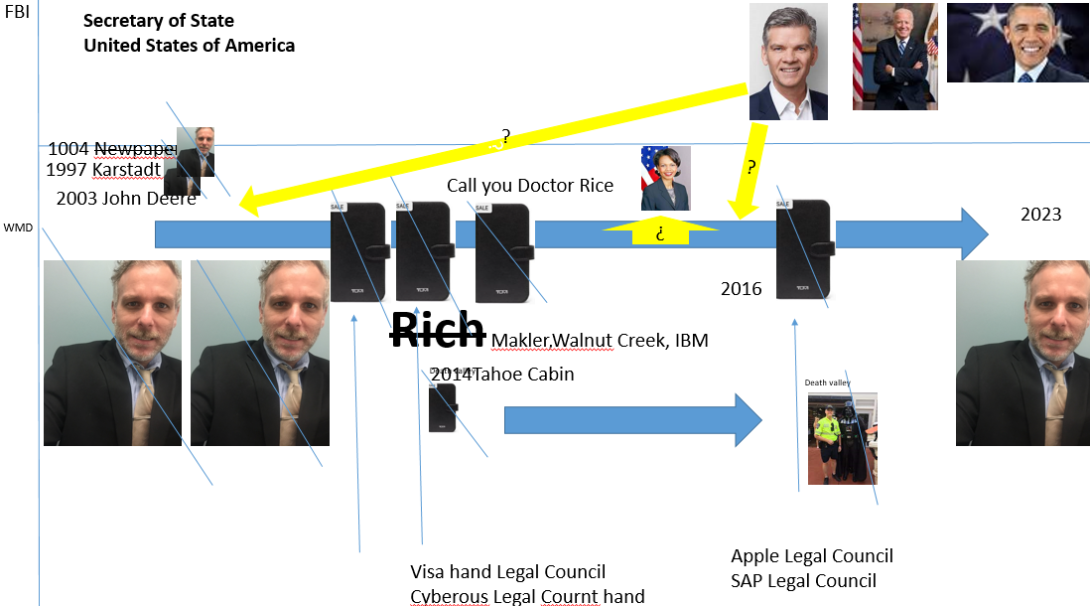
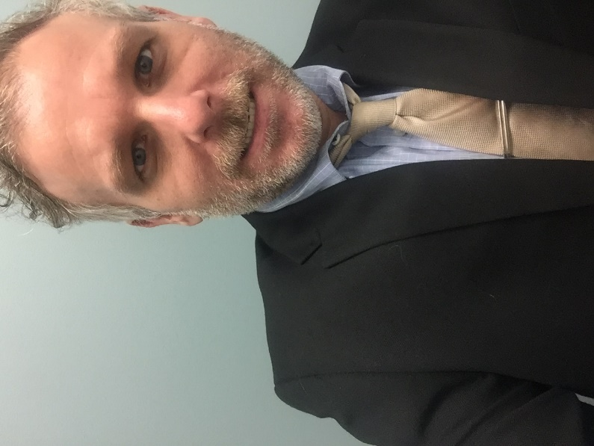
FBI
Secretary of State
United States of America

Slide 9
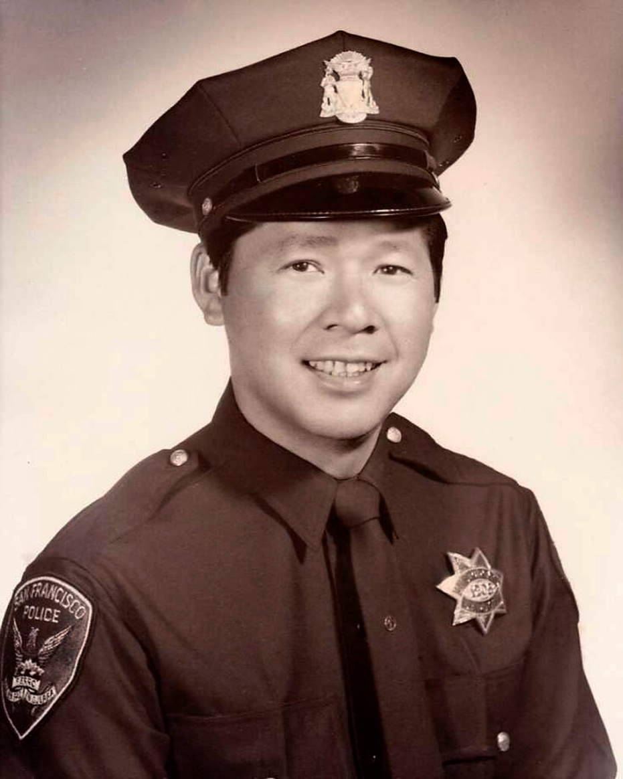
FBI
Secretary of State
United States of America

Slide 10

FBI
Secretary of State
United States of America

Slide 11
FBI
Secretary of State
United States of America
Terh are 2 ppel
Missing
I have to find a
job
Hehas to find a job
I make
2 people
missing

Slide 12
FBI
Secretary of State
United States of America
Harold German
Flags FEDERAL BANK
Alen
Social Security
Daniel
Terh are 2 ppel
Missing
I have to find a
job
Hehas to find a job
I make
2 people
missing

Slide 13


FBI
Secretary of State
United States of America
Harold German
Flags FEDERAL BANK
Alen
Social Security
Daniel
Terh are 2 ppel
Missing
I have to find a
job
Hehas to find a job
MAINSTREET(TORT,parker)
MAINSTREET(LARRY,Daniel,camplter)
FEDERAL BANK(Alen Medselac,Drako)
UNIVIERSTI(stamp pope francsco)
avg

Slide 14
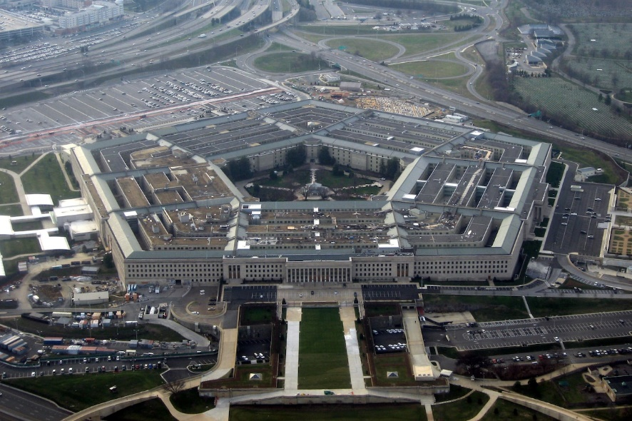

FBI
Secretary of State
United States of America
YANDKE
Terh are 2 ppel
Missing
I have to find a
job
HOMICDE:MAYOR(airiana)
Harold – Sysvets Stalon door right
ACTOMFACTORY(damilerlee)
Harled – Lisa sex with daughter
Harold - German
Harold – Beath up by ASIANS peop at school trainstain
Harold –whitehouse( take house under) gmx,altavisa,darknet HOMICDIE:REISER SUSE Oalkand IBM, OS, ipx roth.ibm.damiler
Harold Junk – tv drunk – (JOHN DEERE) Jeff Jahke Aggerate
Harold …
YANDKE PENTAGON

Slide 15
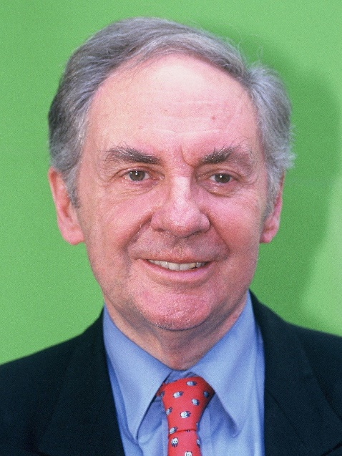
FBI
Secretary of State
United States of America
HOMCEI:PRIDSINET: §1571
HOMICIDE:Sepraty of State.maxplank
roth.ibm.dmiler.moody.dean.?
JFK MLK
HOMICDE:MAYOR(IBM Aria Hotel IPX Floor, Boden)

Slide 16
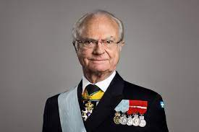
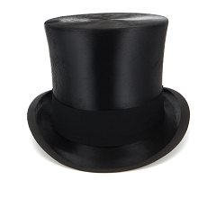

FBI
Secretary of State
United States of America
G

Slide 17
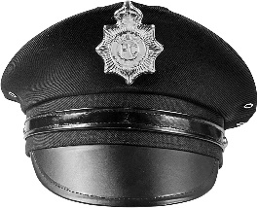
FBI
Secretary of State
United States of America
G

Slide 18

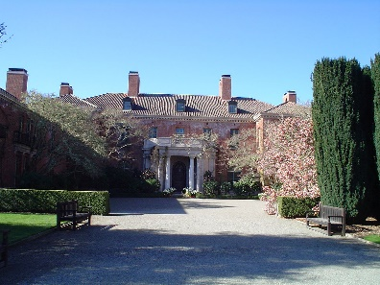

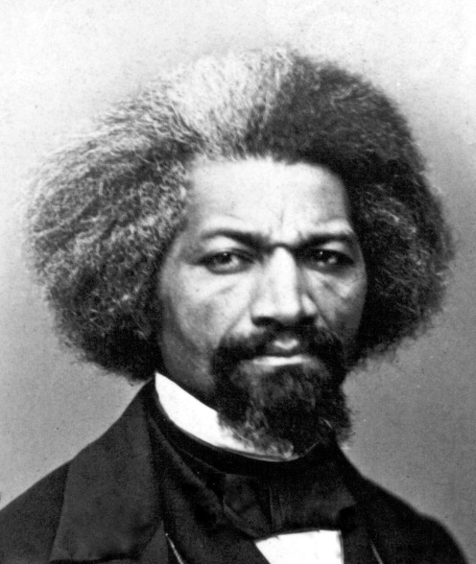

FBI
Secretary of State
United States of America
G
Douglass
MAINSTREET(TORT,parker)
MAINSTREET(LARRY,Daniel,camplter)
FEDERAL BANK(Alen Medselac,Drako)
UNIVIERSTI(stamp pope francsco)
Avg
KING(bismark)

Slide 19

FBI
Secretary of State
United States of America

Slide 20


FBI
Secretary of State
United States of America
Frederick Douglass

Slide 21
FBI
Secretary of State
United States of America

Slide 22

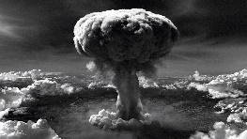

FBI
Secretary of State
United States of America
Frederick Douglass Exit

Slide 23

FBI
Secretary of State
United States of America
Frederick Douglass Exit

Slide 24

FBI
Secretary of State
United States of America
Frederick Douglass Exit

Slide 25
FBI
Secretary of State
United States of America
Frederick Douglass Exit

Slide 26
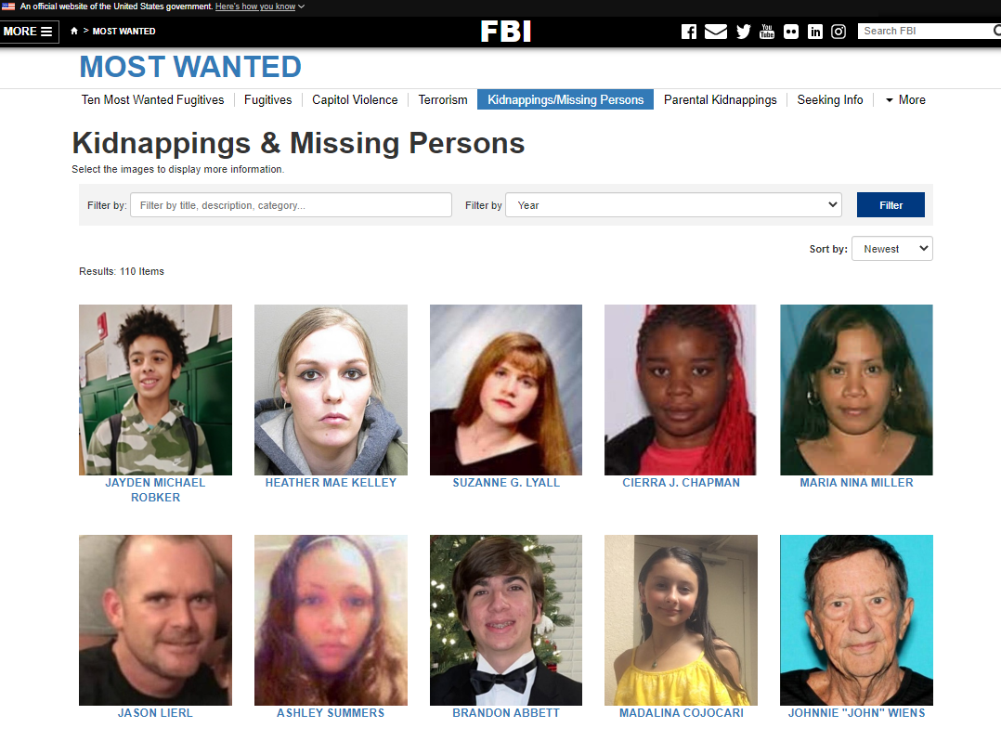
FBI
Secretary of State
United States of America
Frederick Douglass Exit

Slide 27
FBI
Secretary of State
United States of America
Frederick Douglass Exit

Slide 28
FBI
Secretary of State
United States of America
Frederick Douglass Exit

Slide 29
FBI
Secretary of State
United States of America
Frederick
Douglass Exit

Slide 30
FBI
Secretary of State
United States of America
Frederick Douglass

Slide 31
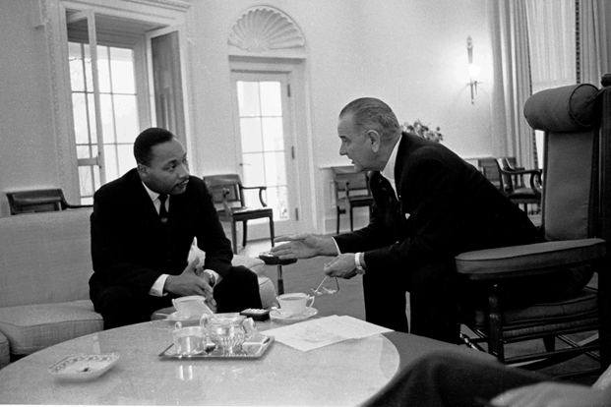
FBI
Secretary of State
United States of America
Frederick Douglass Exit

Slide 32
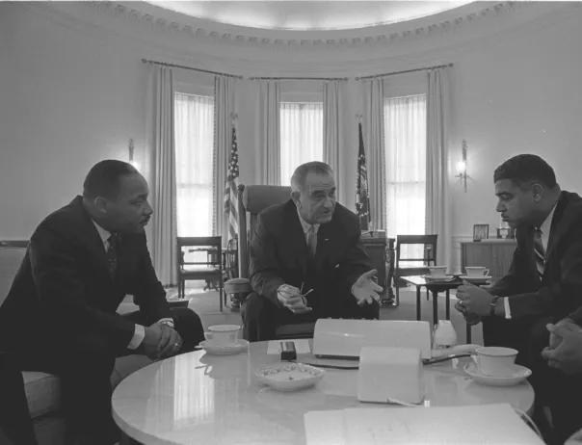
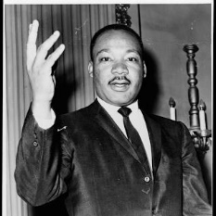
FBI
Secretary of State
United States of America
Frederick Douglass Exit

Slide 33

FBI
Secretary of State
United States of America
Frederick Douglass Exit
MLK Homicide Exit

Slide 34
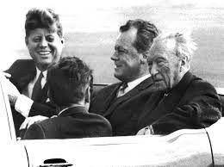
FBI
Secretary of State
United States of America
Frederick Douglass Exit

Slide 35
FBI
Secretary of State
United States of America
Frederick Douglass Exit
JFK Homicide Exit

Slide 36
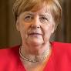
FBI
Secretary of State
United States of America
FIDELITY, BRAVERY, INEGRITY
§1751 PRESIDENT HOMICIDE
Harold Roth

Slide 37

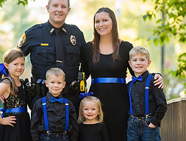
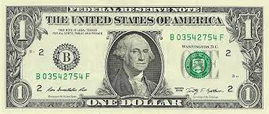

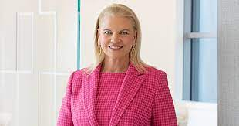

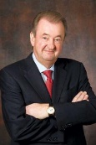


FBI
Secretary of State
United States of America
FIDELITY, BRAVERY, INEGRITY
§1751 PRESIDENT HOMICIDE
Harold Roth
…

Slide 38
FBI
Secretary of State
United States of America
FIDELITY, BRAVERY, INEGRITY
§1751 PRESIDENT HOMICIDE
Harold Roth

Slide 39
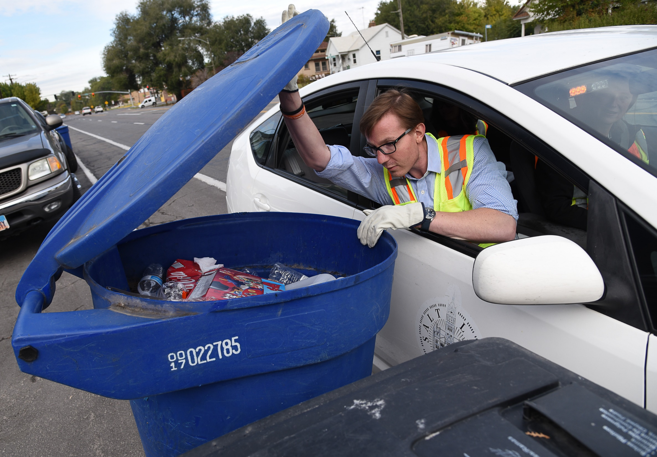
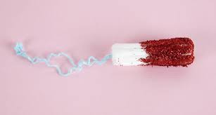
FBI
Secretary of State
United States of America
FIDELITY, BRAVERY, INEGRITY
§1751 PRESIDENT HOMICIDE
Harold Roth

Slide 40
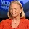



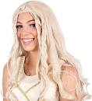
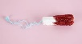
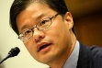


FBI
Secretary of State
United States of America
FIDELITY, BRAVERY, INEGRITY
§1751 PRESIDENT HOMICIDE
Harold Roth
Harold Roth
WWI
JFK.BULLET.KING(bismark,alios-degler)
Mother bring pepsi recling in aldi bag on Chrismas
Harold Roth

Slide 41

FBI
Secretary of State
United States of America
FIDELITY, BRAVERY, INEGRITY
§1751 PRESIDENT HOMICIDE
Harold Roth
Brown =braun
Dauhger of Joseph
BRAUN

Slide 42
FBI
Secretary of State
United States of America
FIDELITY, BRAVERY, INEGRITY
§1751 PRESIDENT HOMICIDE
Harold Roth
Harold Roth
WWI
JFK.BULLET.KING(bismark,alios-degler)
Mother bring pepsi recling in aldi bag on Chrismas
Harold Roth

Slide 43
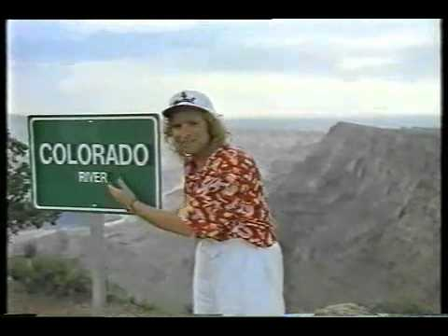
FBI
Secretary of State
United States of America
FIDELITY, BRAVERY, INEGRITY
§1751 PRESIDENT HOMICIDE
Harold Roth
Harold Roth
WWI
JFK.BULLET.KING(bismark,alios-degler)
Mother bring pepsi recling in aldi bag on Chrismas
God Talk Gottshalt, Elke 1994 Santa Criz (CAR(calr-benz)
Pope franceco
Harold Roth

Slide 44
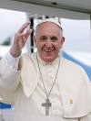
FBI
Secretary of State
United States of America
FIDELITY, BRAVERY, INEGRITY
§1751 PRESIDENT HOMICIDE
Harold Roth
Harold Roth
WWI
JFK.BULLET.KING(bismark,alios-degler)
Mother bring pepsi recling in aldi bag on Chrismas
3HR Talkshow, Famos Crimanls
God Talk Gottshalt, Elke 1994 Santa Criz (CAR(calr-benz)
Pope franceco
Harold Roth

Slide 45
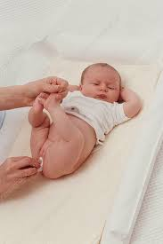
FBI
Secretary of State
United States of America
1992 SCHOOL(ipx marincity,ditzenbach)

Slide 46
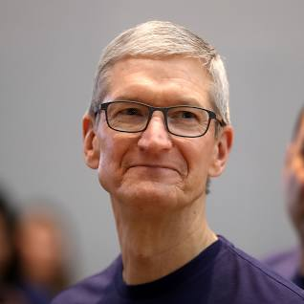
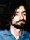

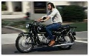
FBI
Secretary of State
United States of America
1992 SCHOOL(ipx marincity,ditzenbach)
[x] no

